Slide 1
How many samples do we need?
Sili Fan statistician, WCMC

Slide 2

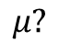
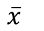
Does your sample represent the population?
We want to know about these
We have these to work with
Population
sampling
Sample
Terminology
Inference
$$μ?$$
$$\overline{x}$$
(Population mean)
(Sample mean)
When sample size is small, samples may not represent the population well. You might draw false conclusions, therefore.

Slide 3
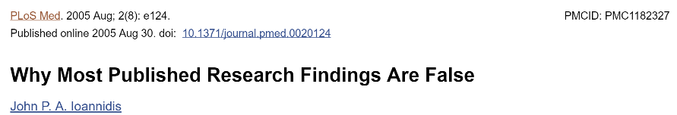
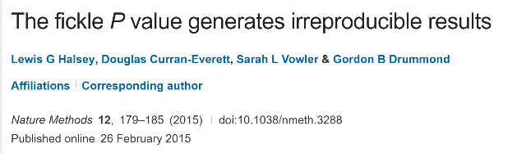
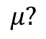
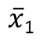
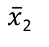
Is your result reproducible?
Sample1
Population
Sample2
Terminology
$\overline{x}$₁
$$μ?$$
$\overline{x}$₂
(Sample1 mean)
(Population mean)
(Sample2 mean)
When the sample size is small, you may have irreproducible result.

Slide 4

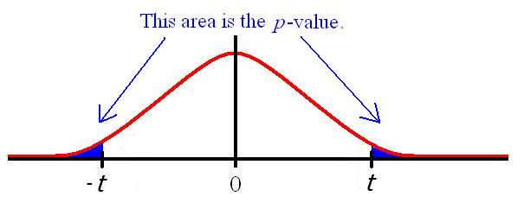
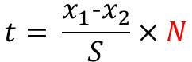
How do we determine significance?
Population1
Population2
Terminology
$$t= \frac{x_{1}−x_{2}}{S}×N$$
The larger the N, the larger the t, the smaller the p value.
When the sample size is small, you have small chance to find significant result.

Slide 5
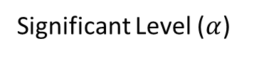
What affects the optimal sample size?
Statistical power: the probability that the test correctly rejects the null hypothesis (H0) when the alternative hypothesis (H1) is true. --wiki
Statistical Power
Sample Size
= 80%
Difference
=
Variation
Factors
5% =
Significant Level ($α$)
Effect Size
Notes:
Know three, know the fourth.

Slide 6
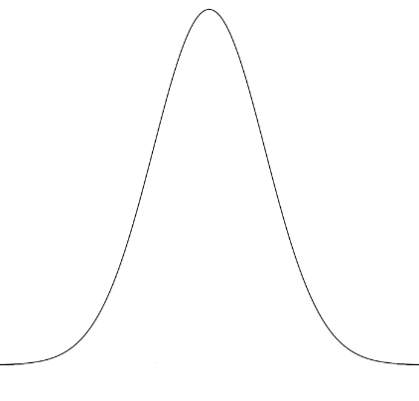
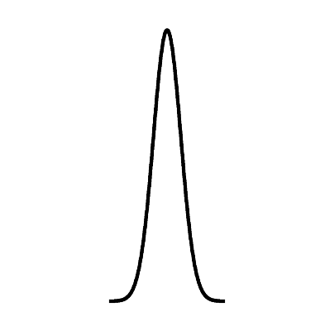
What affects the optimal sample size?
Difference
Sample Size
Effect Size
=
Variation
The smaller the difference, the more samples we need to detect difference
Factors
The smaller the variation, the less samples we need to detect difference

Slide 7
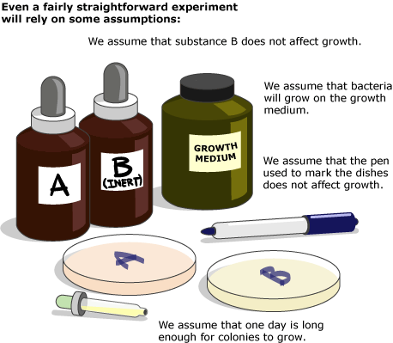
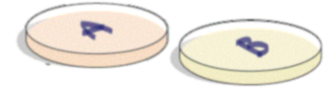
What affects the effect size?
Difference
Sample Size
Effect Size
=
Variation
Increase the Difference
Decrease the Variation
Difference/Variation
We assume that Petri dishes won’t affect growth.
……
Pic from:
http://undsci.berkeley.edu/article/howscienceworks_13
Notes:
For example, imagine a very simple test of the hypothesis that substance A stops bacterial growth. Some Petri dishes are spread with a mixture of substance A and bacterial growth medium, and others are spread with a mixture of inert substance B and bacterial growth medium. Bacteria are spread on all the Petri dishes, and one day later, the plates are examined to see which fostered the growth of bacterial colonies and which did not.

Slide 8
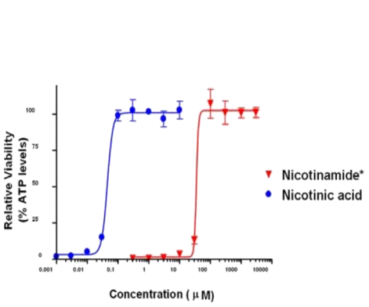
What affects the effect size?
Design Your Study to Collect Adequate Exposures
Difference
Sample Size
Effect Size
=
Variation
Increase the Difference
tips
“Exposures” refers to dose or time. Multi-exposure point studies, such as a time-course study or a multi-dose study, increases your chance of seeing meaningful variations.
Increase the difference
A good rule of thumb is to collect samples at a “mild”, “moderate” and “severe” exposures to ensure that all salient cause and effect changes are captured.
Notes:
Sometimes when the dose is larger the effect is larger. Sometimes the effect will decrease after a certain amount of does. So we better add a moderate level.

Slide 9
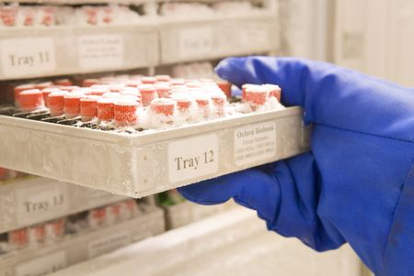
What affects the effect size?
Difference
Sample Size
Effect Size
=
Variation
tips
Decrease the Variation
sample collection variation
consistent in sample collection and handling is essential
Temperature,
Aliquoting,
Biobanking,
…
Decrease the Variation
the inherent variability in the model/cohort under study
gender, BMI, age, race, lifestyle, …
cell
small animals
large animals
human
repeated measure?
The more variation you can control for, the less samples are required. The less variation you can control for, the more samples you need to overcome the variation.

Slide 10
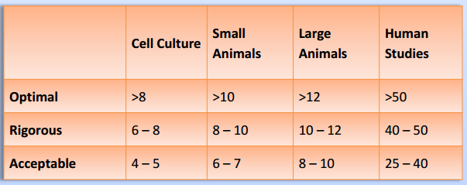

How to calculate the optimal sample size
Significant Level ($α$) = 0.05
Statistical Power = 80%
Difference
Sample Size
Effect Size????
Variation
0. understand if the treatment effects are dramatic or subtle
1. Rule of Thumb
Given by metabolon
2. Independent t test: small (0.2), medium (0.5) and large (0.8) - Cohen
Calculate Sample Size
Independent ANOVA: small (0.1), medium (0.25) and large (0.4) - Cohen
Other tests: small (?), medium (?) and large (?)
These cut-offs were introduced by Cohen himself, but with a strong caution that "this is an operation fraught with many dangers" (Cohen, 1977).
3. Estimate effect size with pilot study (using estimated means and standard deviations).
Do your samples in the pilot study represent the population?
Sample Size Calculator
G*Power
Metaboanalyst – Power Analysis
Notes:
0. Like Toxicological experiment.
3.Pilot studies represent a fundamental phase of the research process. The purpose of conducting a pilot study is to examine the feasibility of an approach that is intended to be used in a larger scale study.

Slide 11
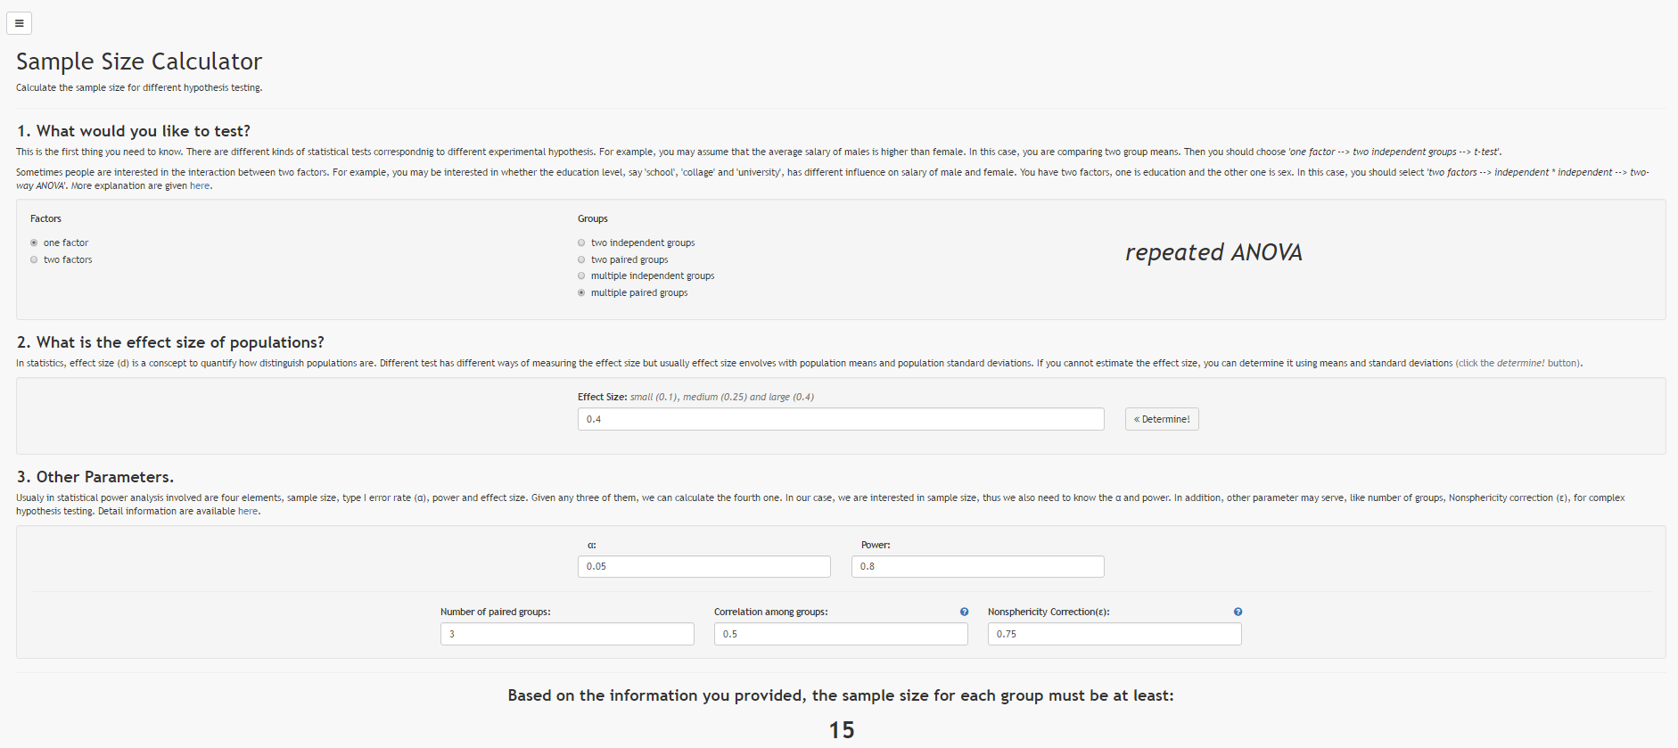
Sample Size Calculator

Slide 12
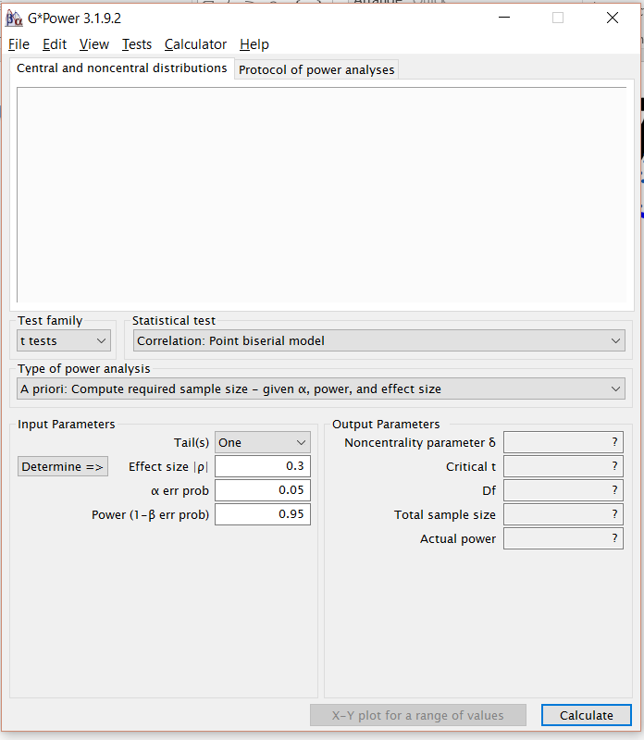
G*Power 3.1
http://www.gpower.hhu.de/en.html

Slide 13
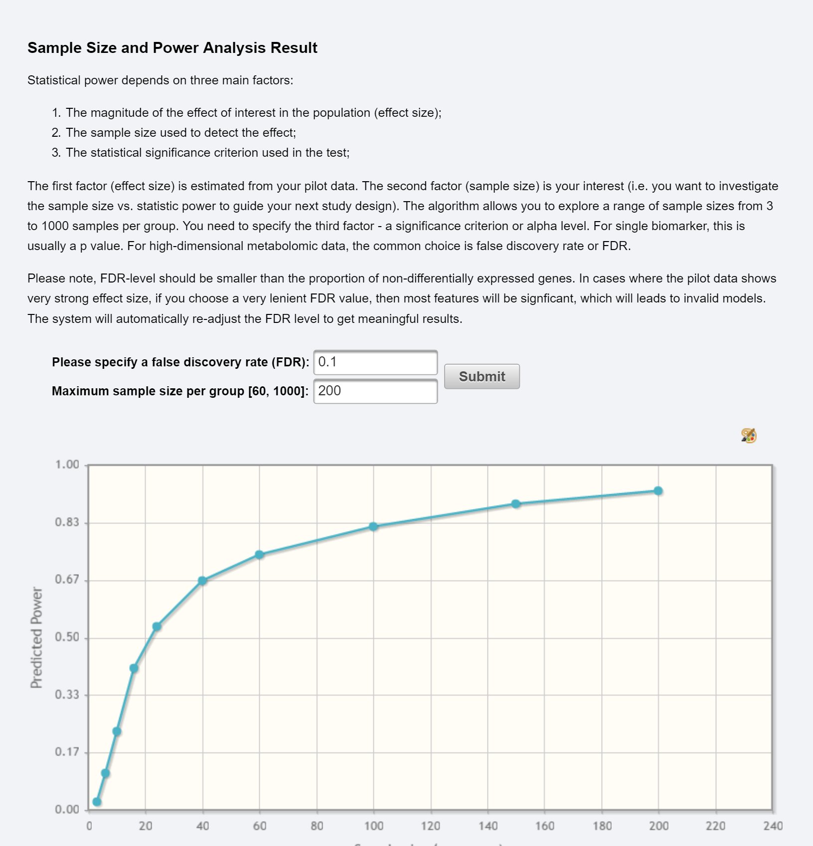
MetaboAnalyst – Power Analysis
http://www.metaboanalyst.ca/faces/Secure/upload/PowerUploadView.xhtml

Slide 14
How many samples do we need?
Consequence of small sample size:
1. Samples do not represent population → wrong conclusion.
2. Irreproducible result.
3. no significance
To estimate sample size:
You need to know or estimate the effect size (difference & variation)

Slide 15
*Disclaimer What about the optimal sample size for Multivariate Analysis?
We only talked about sample size for one compound (Univariate Analysis)
Multivariate Analysis: Optimal sample size is not clear.
As rule of thumb, use 10 observations per parameter.
Notes:
Different multivariate model has different number of parameters.

Slide 16
How many samples do we need?
tools
Sili Fan WCMC statistician

Slide 17


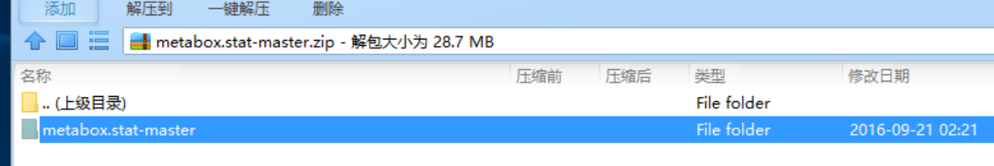
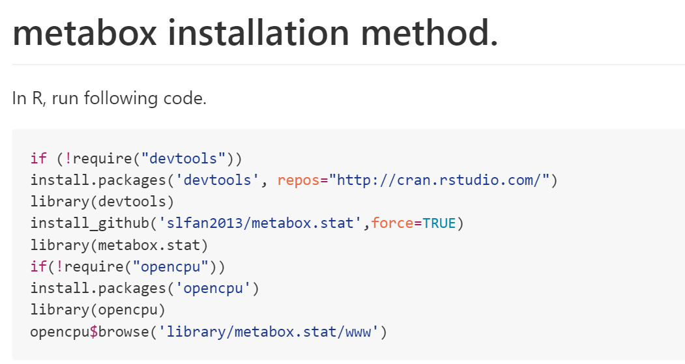

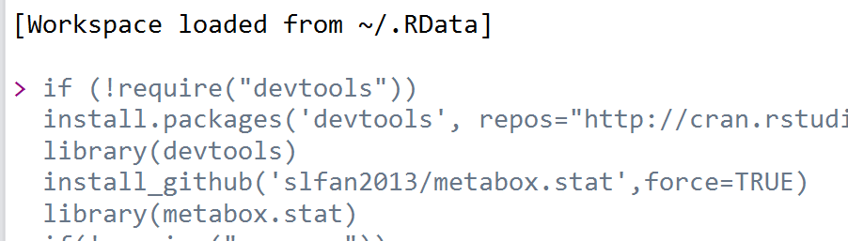
Install the Tool
1. https://github.com/slfan2013/metabox.stat
2. Download the file
Install
3. Save Data
open
save
4. Run Following Code
open
Copy+Paste in r Studio

Slide 18
Calculate Sample Size
Significant Level ($α$) = 0.05
Statistical Power = 80%
Sample Size
Effect Size????
0. under stand if the treatment effects are dramatic or subtle
1. Rule of Thumb
2. Independent t test: small (0.2), medium (0.5) and large (0.8) - Cohen
Calculate Sample Size
Independent ANOVA: small (0.1), medium (0.25) and large (0.4) - Cohen
Other tests: small (?), medium (?) and large (?)
These cut-offs were introduced by Cohen himself, but with a strong caution that "this is an operation fraught with many dangers" (Cohen, 1977).
3. Estimate effect size with pilot study (using estimated means and standard deviations).
Do your samples in the pilot study represent the population?
Sample Size Calculator
G*Power
Metaboanalyst – Power Analysis
Notes:
Pilot studies represent a fundamental phase of the research process. The purpose of conducting a pilot study is to examine the feasibility of an approach that is intended to be used in a larger scale study.

Slide 19
Sample Size Calculator

Slide 20
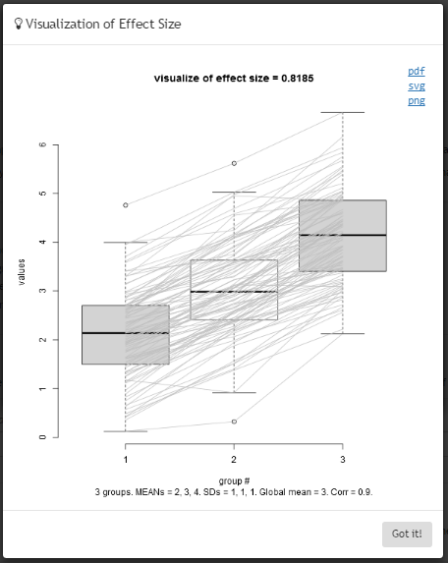
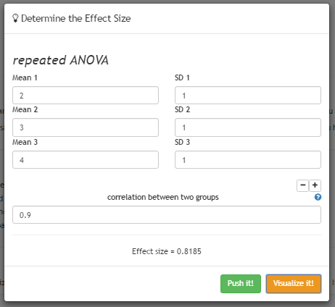
Sample Size Calculator
Visualize Sample Size
Estimate Sample Size

Slide 21
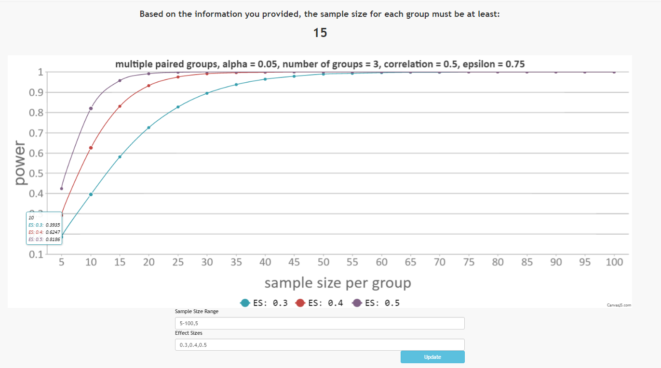
Sample Size Calculator
Power-Sample Size plot

Slide 22
G*Power 3.1
http://www.gpower.hhu.de/en.html

Slide 23
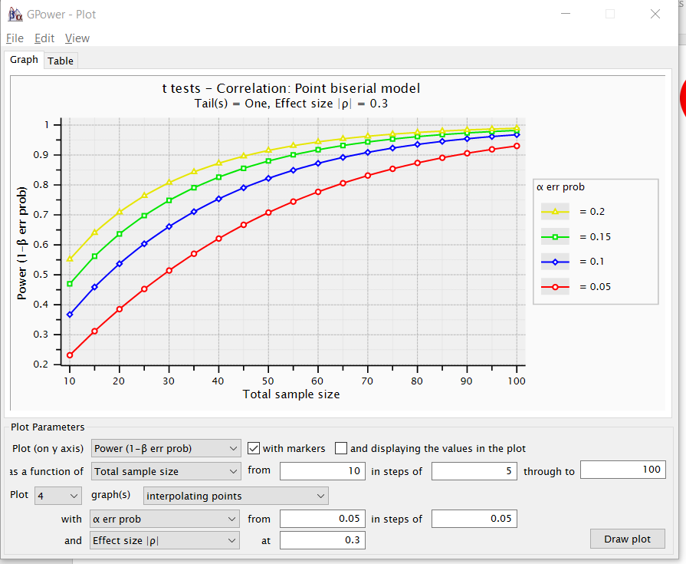
G*Power 3.1

Slide 24
Univariate Analysis
Sili Fan WCMC statistician

Slide 25
Study Objective
Generally :
1. Why univariate analysis?
2. What is hypothesis testing?
3. What is p value?
Specifically :
1. What hypothesis testing procedure should I use?
1.1 Parametric vs. non-parametric
1.2 Study design → hypothesis testing methods
1.3 Multi-Comparison problem
2. Visualization
3. What else?

Slide 26
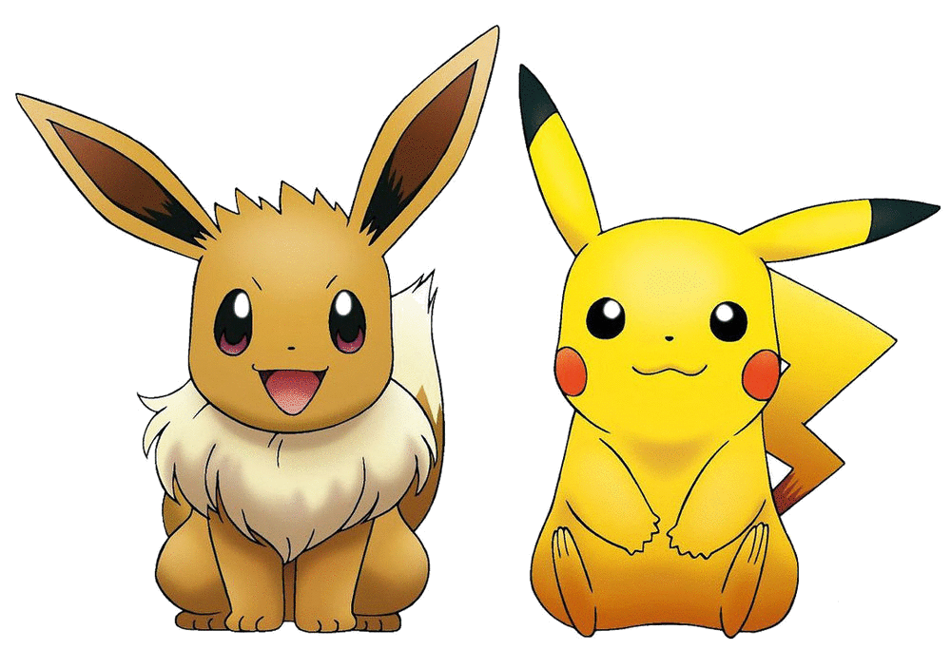
Why univariate analysis?
Univariate analysis means : analyzing metabolite one at a time (to test which one is associated with phenotype of interest).
With multivariate analysis:
Color + Number of fingers + hair style
With univariate analysis:
Color
Size of eyes
Length of tail
Number of fingers
Hair style
Existence of eyebrows
…
Univariate can find almost all the relevant features;
Multivariate can find a group of features to make good classifications
Experimental: hypothesis testing
*Observational: (simple linear) regression
Notes:
Experimental: categorical outcome.
Observational: continues outcome.

Slide 27
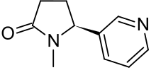

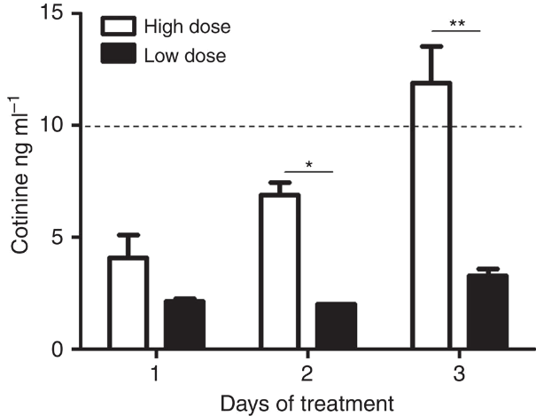
What is hypothesis testing?
Hypothesis is an assumption about a population parameter. (e.g. average)
Hypothesis testing refers to the formal procedures to reject statistical hypothesis.
Cotinine ←→ smoking
Hypothesis: level of cotinine is not influenced by the exposure to cigarette smoke.
(null hypothesis: x_{non-smoke} = x_{smoke})
Hypothesis testing:
1. Compute test statistic, t, from the observations.
2. Calculate the p-value.
3. Reject the null hypothesis when p-value is less than a threshold, e.g., 0.05 (then make conclusion).
The level of cotinine in blood provides a direct quantification of the nicotine intake and is therefore a valuable indicator of tobacco smoke exposure.
pic: http://www.nature.com/articles/ncomms2494
Notes:
Why hypothesis is null? Might be verifiability and falsifiability.

Slide 28
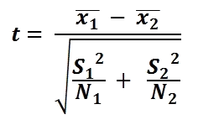
What is a p-value?
p-value: a function of the observed sample results (a test statistic) relative to a statistical model, which measures how extreme the observation is (under the null hypothesis ). -- wiki
under null hypothesis
test statistic
Cotinine ←→smoking
null hypothesis: x_{non-smoke} = x_{smoke}
test statistic:
What is the test statistics under the null hypothesis?
p-value: the probability of the test statistic under the null hypothesis.

Slide 29
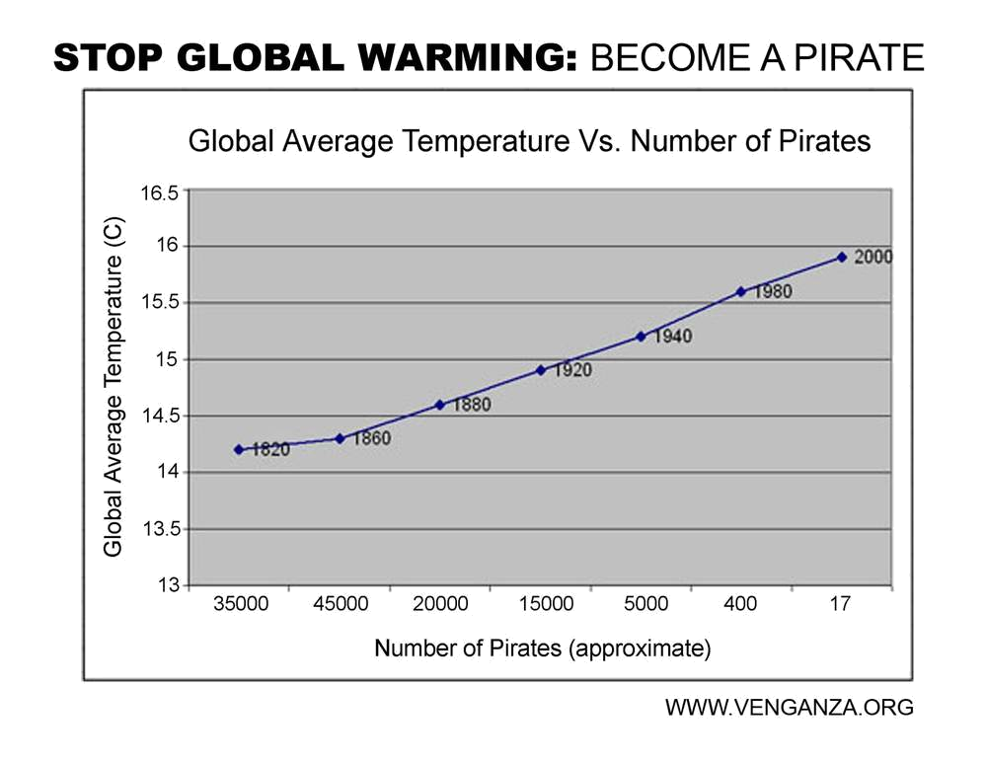
What is a p-value?
Be careful and critical
p-value = P(obs|null hypothesis) $≠$ P(null hypothesis|obs)
null hypothesis: N_{14°C} = N_{16°C}
Nickerson’s (2000) excellent review “Null Hypothesis Significance Testing: A Review of an Old and Continuing Controversy”.
We still do not know whether the null hypothesis is true or not!
p-value only helps you cast doubt on null hypothesis.
Notes:
So we should confirm the conclusion we made with multiple following experiments.

Slide 30
What hypothesis testing procedure should I use?
Parametric
Non Parametric
Assumptions
Normality (Shapiro test)
Equal variance (Levene Test)
Sphericity (Mauchly Test)
Equal covariance (Box Test) Sensitive to outliers
Robust with assumptions (when sample size is large and equal among groups)
Powerful (when assumptions are met)
Assumption free
Less affected by outliers
Powerful (when assumptions violated)
Hypothesis: level of cotinine is not influenced by the exposure to cigarette smoke.
(null hypothesis: x_{non-smoke} = x_{smoke})
Hypothesis testing:
1. Compute test statistic, t, from the observations.
2. Calculate the p-value.
3. Reject the null hypothesis when p-value is less than a threshold, e.g., 0.05 (then make conclusion).
Notes:
Nonparametric tests are also called distribution-free tests because they don't assume that your data follow a specific distribution.

Slide 31
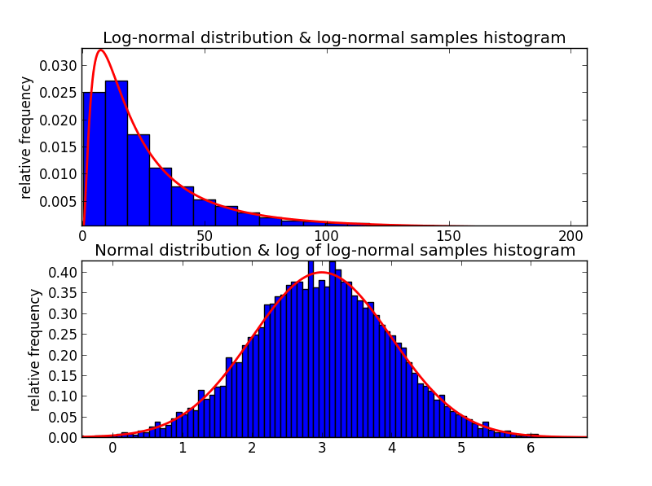
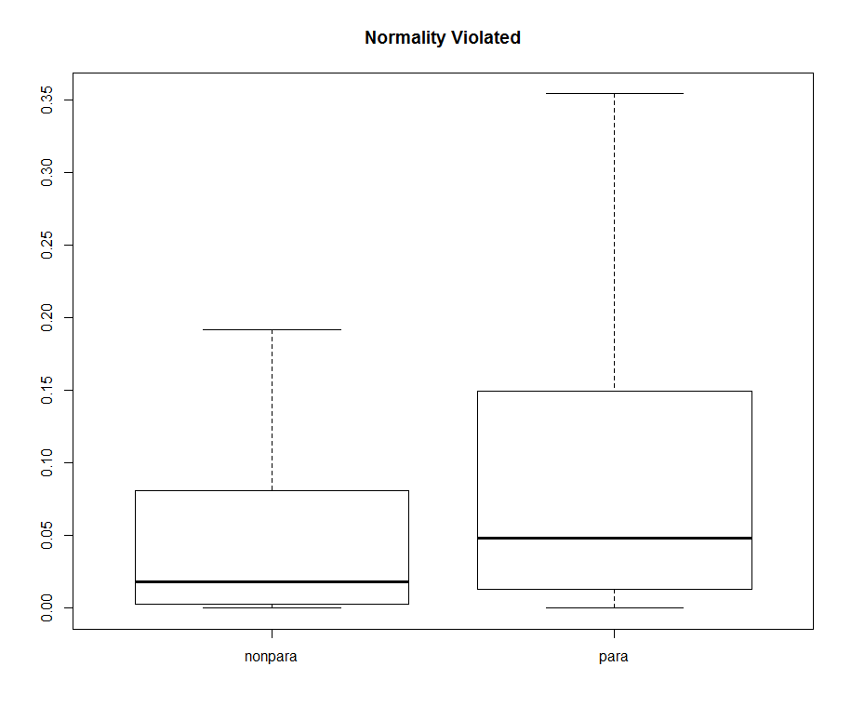
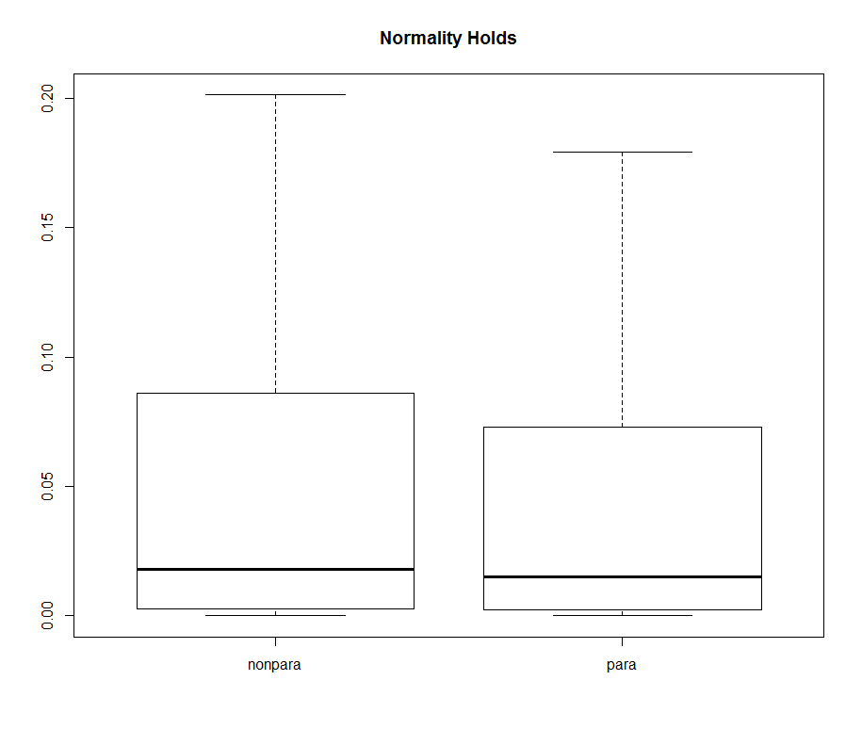
Non parametric test or parametric test?
Assumptions
Normality
Non para vs. para
log normal
Population 1: mean = 0; sd = 1;
Population 2: mean = 0.8; sd = 1;
Sample size = 20;
normal
When normality is violated, nonparametric is more powerful.
When normality holds, parametric is a little bit more powerful.

Slide 32
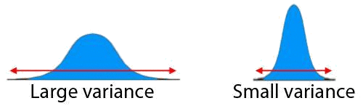
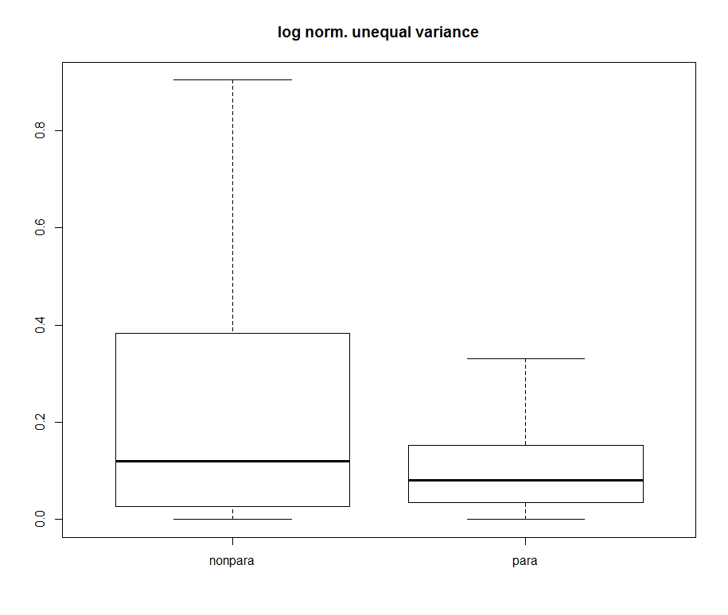
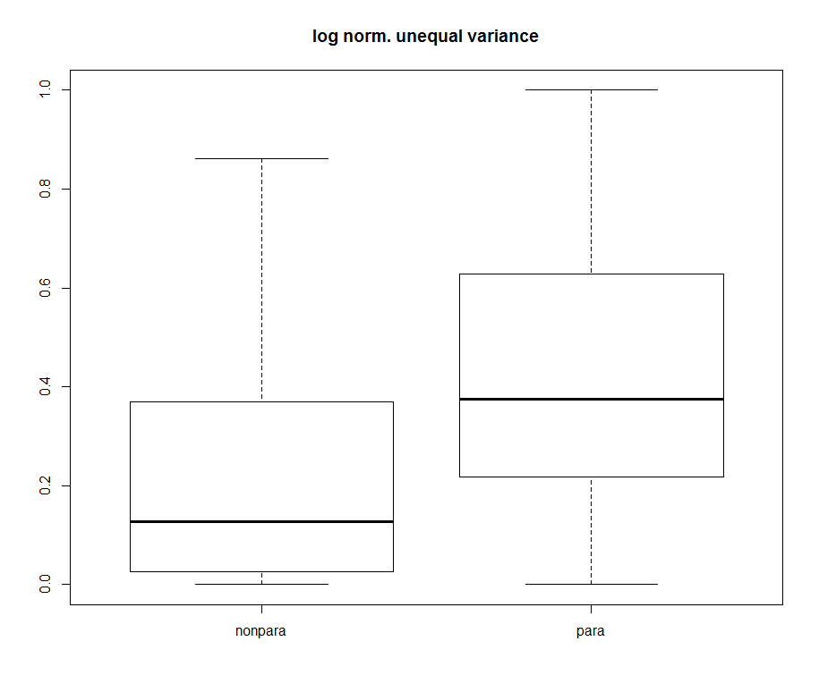
Non parametric test or parametric test?
Assumptions
Equal variance
Non parametric vs. parametric
Population 1:
mean = 0; sd = 1;
Population 2:
mean = 0.8; sd = 2;
Sample size = 20;
Population 1:
mean = 0; sd = 2;
Population 2:
mean = 0.8; sd = 1;
Sample size = 20;
Large mean large variance
small mean large variance
Depending on which group has a larger variance, non parametric test and parametric test have different power.

Slide 33
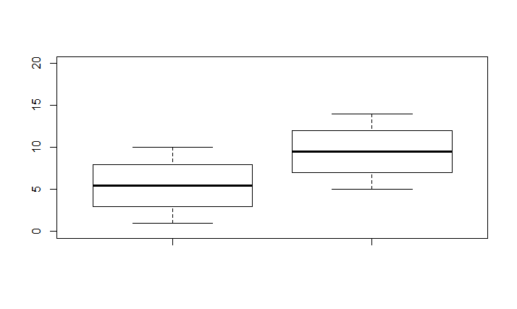
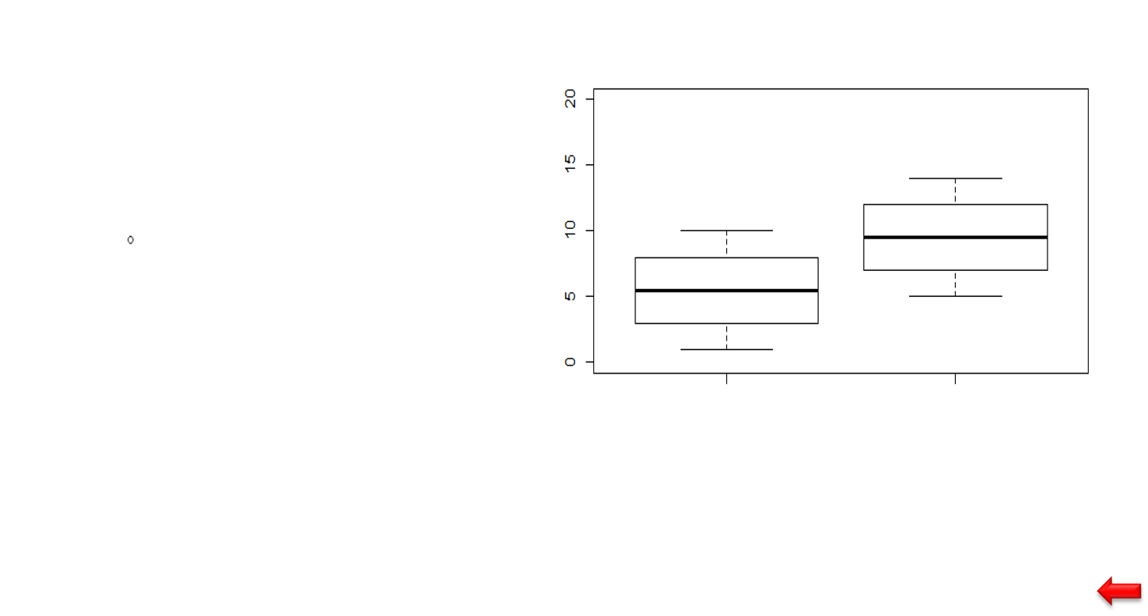
Non parametric test or parametric test?
Outlier
→ 0.091
para
p = 0.008
nonpara
→ 0.022
p = 0.012
Non parametric test is more robust than parametric test with respect to outliers

Slide 34

Personal statements
Non parametric test or parametric test?
When sample size is not extremely small, I slightly prefer nonparametric test because it is robust with outlier.
What I usually do is to: perform both non parametric and parametric test and consider features when non parametric and parametric have controversy result.
Sili Fan, September 2016

Slide 35
Study design and corresponding tests
Study Design
Statistical tests
Two group independent.
Two group paired.
Multi-group independent.
Longitudinal
Crossed Designs.
Are these two groups different?
T test^{1,2}, welch t test¹, U test, …
Paired T test¹, W test, …
ANOVA^{1,2}, Kruskal–Wallis ANOVA,…
Repeated ANOVA^{1,2,3}, Friedman Test, …
Two way ANOVA^{1,2,3,4}, Ordinal Logistic Regression…
Is there any group different from others?
interacting?
Multiple comparison problem!

Slide 36
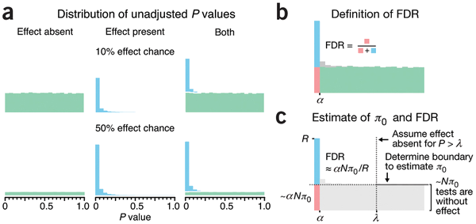
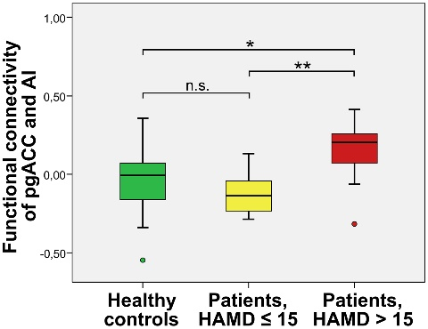
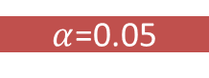

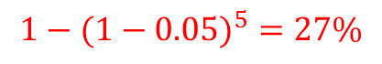


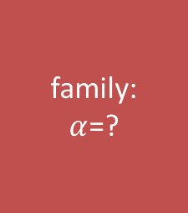


Study design and corresponding tests
multiple comparison problem
1. FDR Correction
corrects False Discovery Rate
Hypothesis: level of cotinine is not influenced by the exposure to cigarette smoke.
(null hypothesis: x_{non-smoke} = x_{smoke})
Hypothesis testing:
1. Compute test statistic, t, from the observations.
2. Calculate the p-value.
3. Reject the null hypothesis when p-value is less than a threshold, e.g., 0.05 (then make conclusion).
Use FDR correction
among features
P value
P value
P value
Out of 1000 compounds, by chance there will be 50 significant ones!
2. Bonferroni Correction
corrects Familywise Error Rate
individuals
$α$=0.05
family:
$α$=?
$α$=0.05
Use Bonferroni
within features
(post hoc analysis)
$α$=0.05
$α$=0.05
$α$=0.05
$${1−(1−0.05)}^{5}=27\%$$
$α$: error rate
Notes:
2. Bonferroni correction.
The error rate for each test is 5 percent. What about the error rate for 5 tests?

Slide 37
Study design and corresponding tests
Study Design
Statistical tests
Two group independent.
Two group paired.
Multi-group independent.
Longitudinal
Crossed Designs.
Are these two groups different?
T test^{1,2}, welch t test¹, U test, …
Paired T test¹, W test, …
ANOVA^{1,2}, Kruskal–Wallis ANOVA,…
Repeated ANOVA^{1,2,3}, Friedman Test, …
Two way ANOVA^{1,2,3,4}, Ordinal Logistic Regression…
Is there any group different from others?
interacting?
Multiple comparison problem!
To correct for multiple comparison problem,
for two groups design, use FDR.
for more than two groups, use Bonferroni Correction at post hoc analysis.

Slide 38
Study design and corresponding tests
two independent groups
subjects are different between two groups
For example, determine whether (mean) salaries, measured in US dollars, differed between males and females
Welch t test
normality;
Mann-Whitney U test
assumptions;
Parametric
Non-parametric

Slide 39
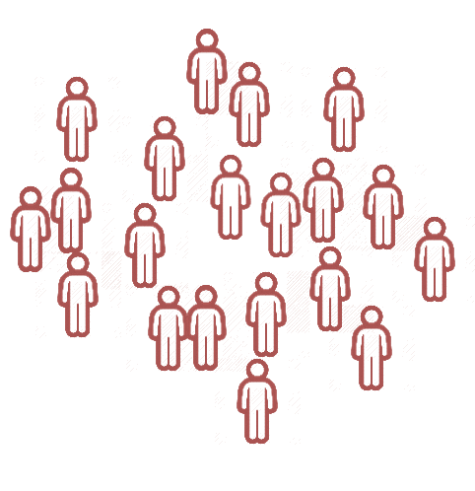
Study design and corresponding tests
two paired groups
subjects are same between two groups
Time
For example, to understand whether there was a mean difference in daily calorie consumption before and after a six week hypnotherapy program.
paired t test
normality;
Wilcoxon signed-rank test
assumptions;
Parametric
Non-parametric

Slide 40
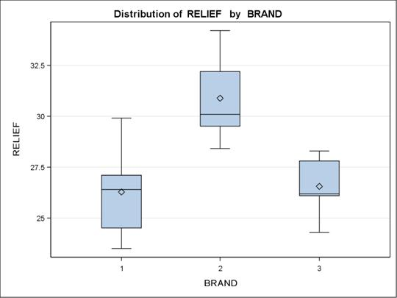
Study design and corresponding tests
multiple independent groups
subjects are different among groups
For example, to determine whether exam performance differed based on test anxiety levels, low, medium and high, amongst students
Welch ANOVA
normality;
Kruskal-Wallis H test
ANOVA would tell use there is at least one group that is different from others.
But which group exactly?
Games-Howell test
Post Hoc Analysis
normality;
Mann Whitney U test
with Holm–Bonferroni correction
assumptions;
Parametric
Non-parametric

Slide 41
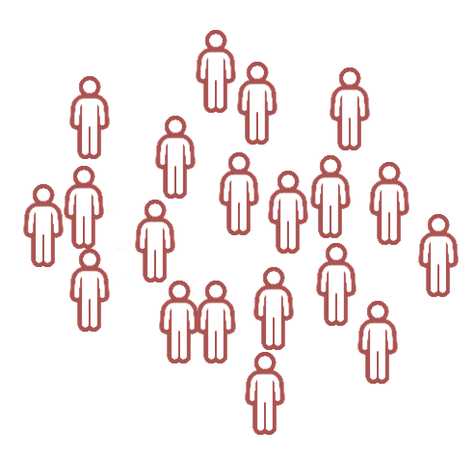
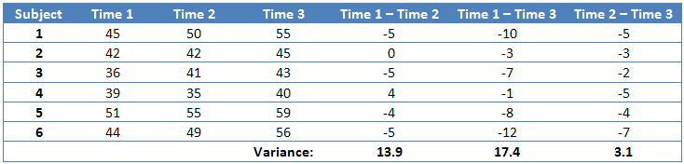
Study design and corresponding tests
multiple paired groups
subjects are same among groups
Sphericity
Time
For example, to determine whether exam performance differed based on test anxiety levels amongst students
repeated ANOVA
with Greenhouse-Geisser correction
normality, sphericity;
Friedman test
paired t test
With Holm–Bonferroni correction
Post Hoc Analysis
normality;
Wilcoxon signed-rank test
with Holm–Bonferroni correction
assumptions;
Parametric
Non-parametric

Slide 42
Study design and corresponding tests
independent * independent
subjects are different among groups
drug
current
low
medium
high
one direction
experiment
risk
one direction
For example, consider an experiment where two drugs were being given to patients to treat heart disease. One of the drugs was the current drug being used to treat heart disease and the other was an experimental drug that the researchers wanted to compare to the current drug. The researchers also wanted to understand how the drugs compared in low, medium and high risk patients.
The two independent variables are drug with two levels ("Current" and "Experimental") and risk with three levels ("Low", "Medium" and "High").
two-way ANOVA
normality, equal variance;
*bootstrap approaches
assumptions;
* http://sites.stat.psu.edu/~mga/papers/akr.jasa.90/rt.jasa.90.pdf
Parametric
Non-parametric

Slide 43
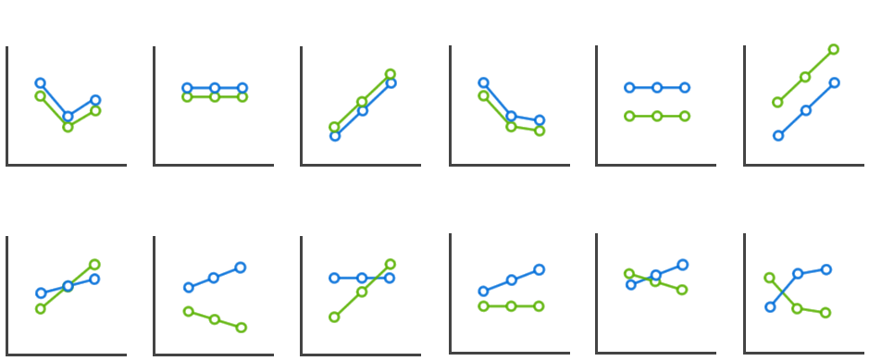
Study design and corresponding tests
independent * independent
subjects are different among groups
(cont’d)
two-way ANOVA
with Greenhouse-Geisser correction
Primary Interest: Interaction between two factors.
For example, whether the current drug and experiment drug have different effect among risks.
Not Significant
Significant
Secondary Interest: simple main effect and main effect.
When not significant, we continue with main effect.
When significant, we continue with simple main effect.

Slide 44
Study design and corresponding tests
independent * independent
subjects are same among groups
(cont’d)
drug
current
one direction
experiment
risk
main effect
the effect of an factor on a dependent variable averaging across the levels of any other factors. --wiki
What kind of study design does this become?

Slide 45
Study design and corresponding tests
independent * independent
subjects are same among groups
low
medium
high
drug
risk
one direction
main effect
the effect of an factor on a dependent variable averaging across the levels of any other factors. --wiki
What kind of study design does this become?

Slide 46
Study design and corresponding tests
independent * independent
subjects are same among groups
drug
current
(or experiment)
low
medium
high
one direction
risk
Simple main effect
is the effect of one independent variable within one level of a second independent variable. --psu
What kind of study design does this become?

Slide 47
Study design and corresponding tests
independent * independent
subjects are same among groups
drug
current
one direction
medium
experiment
Simple main effect
is the effect of one independent variable within one level of a second independent variable. --psu
What kind of study design does this become?

Slide 48
Study design and corresponding tests
independent * paired
intensity
subjects are same among paired groups
high
0 month
3 month
6 month
moderate
one direction
risk
low
time
one direction
For example, to understand if blood cholesterol concentration changes over time (e.g., 0, 3 and 6 months) if one embarks on an exercise-training program of either low, moderate or high intensity. Importantly, you would usually want to know if blood cholesterol concentration changed differently over time depending on which exercise-training program was performed (e.g., either the low, moderate or high intensity exercise-training program). Understanding the latter requires the analysis of the interaction effect. In essence, you want to distinguish between the effects of different exercise-training interventions over time.
mixed ANOVA
with Greenhouse-Geisser correction
normality, equal variance, sphericity, equal covariance;
assumptions;
Parametric
Non-parametric

Slide 49
Study design and corresponding tests
independent * paired
(cont’d)
subjects are same among paired groups
mixed ANOVA
with Greenhouse-Geisser correction
Primary Interest: Interaction between two factors.
Secondary Interest: simple main effect and main effect.
When not significant, we continue with main effect.
When significant, we continue with simple main effect.
Be aware what kind of study design it becomes for main effect and simple main effect.

Slide 50
Study design and corresponding tests
paired * paired
subjects are same among paired groups
color
blue
overcast
sunny
one direction
snow
yellow
weather
one direction
For example, imagine you are interested in the effect of two different types of ski goggle (i.e., blue-tinted or gold-tinted ski goggles) on ski performance (i.e., time to complete a ski run). In particular, you are concerned that the effect of the different lens colors on ski performance might be different depending on whether it is overcast or sunny (i.e., under different weather conditions). You suspect that ski performance will depend on both ski goggle lens color and the weather conditions. As such, you want to determine if a two-way interaction effect exists between ski goggle lens color and weather conditions (i.e., the two within-subjects factors) in explaining ski performance.
time
mixed ANOVA
with Greenhouse-Geisser correction
normality, equal variance, sphericity, equal covariance;
Be aware what kind of study design it becomes for main effect and simple main effect.
assumptions;
Parametric
Non-parametric

Slide 51

Visualization
b) 4 plots visualizing 100 samples of each distribution
a) 4 statistical distributions.
Bar plot shows the mean, s.d. and s.e.m.
Violin plot and bean plot represent the distribution. Less statistically informative and sensitive to outliers;
Box plot shows five-number summary (min, low quantile, median, high quantile and maximum) and outlier;

Slide 52


Visualization
boxplot
What is distribution type of the red box plot?

Slide 53
What else?
the univariate analysis is certainly not the end of the story
examination
correlation between compounds
biological inference
limitation of univariate analysis
ignore relationship between features
Enrichment analysis,
Meta-analysis,
Multivariate analysis,
…

Slide 54


What else?
Linear regression
vs.
hypothesis testing data
simple linear regression data
categorical
continuous

Slide 55


What else?
ROC Curve
Type II: null hypothesis correct,
but we conclude it is wrong
Type I: null hypothesis correct,
but we conclude it is wrong
ROC: receiver operating characteristic
visualization

Slide 56
p-value only helps you cast doubt on null hypothesis but it does not tell you whether the null hypothesis is right or wrong.
Selecting an appropriate hypothesis procedure corresponding to study design is critical.
For two-factor study design, we should focus on interaction term first.
It is always a good practice to visualize the data before and after analysis.
final reminders

Slide 57
Introduction to metabox.stat
Sili Fan WCMC statistician

Slide 58
Basic working flow
Data uploading
Data normalization
Univariate analysis

Slide 59

first row & first column must be empty
Data File Format
“ID” is important for paired data
Sample Info (Meta Data)
Compound Info
values
first sheet
The first row and first column are critical for metabox.stat to automatically identify sample info, compound info and values.
Data file must be in the first sheet of xlsx.

Slide 60

Data File Uploading
Click to use example data
click to upload file

Slide 61

Data File Uploading

Slide 62

Missing Value Imputation

Slide 63

Data Normalization
Apply normalization method
Display the information of selected samples
Visualize the performance of normalization with PCA

Slide 64



Data Normalization
(apply normalization method)
Samplewise normalization
after = before * ratio

Slide 65

Data Normalization
(apply normalization method)
after log
Outlier gone!
before
Data transformation
Won’t influence the non parametric test

Slide 66

Data Normalization
(apply normalization method)
featurewise normalization
Important for multivariate analysis (including PCA)
Won’t influence the hypothesis testing result

Slide 67

Data Normalization
(visualize the performance)
Change color with different sample info
Click to select samples

Slide 68

Data Normalization
(visualize the performance)
No normalization
Normalized to urine volume
Normalized to osmolality
Normalized to creatinine concentration
Select the normalization method that reveals most of the biological difference
normalized to mTIC
http://www.sciencedirect.com/science/article/pii/S157002320900021X

Slide 69

Data Normalization
(visualize the performance)
Display the info of selected samples

Slide 70

Hypothesis Testing
Specify Study Design
Sample Size for each group
Submit!

Slide 71

Download The Result
Delete unwanted columns
Download the results

Slide 72

Download The Result
Input a compound name

Slide 73
Exercise Univariate Analysis
Make sure read the xlsx file first.
Then make sure you understand the study design.
Finally, use boxplot to visualize the data before making any conclusion.
A
B
C
D

